Slide 1

Network Attached Storage

Slide 2
What is Network Attached Storage (NAS)
The simplest way to think of NAS is as a specialized file server. It allows data storage and retrieval from a central location for authorized network users and various clients.
In other words, NAS is similar to having your private cloud in a home or an office. However, it is faster, less expensive, and offers all of the benefits of a public cloud on-premises, giving you complete control.

Slide 3
Types of NAS
Prebuilt (Synology, Qnap, Asustor, Western Digital, Seagate, Buffalo Terastation, Buffalo TerraMaster, and others)
Personal Computer

Slide 4
NAS Software
FreeNAS/TrueNas Core https://www.truenas.com
TrueNAS Scale https://www.truenas.com/truenas-scale/
Rockstor https://rockstor.com
Ubuntu Server https://ubuntu.com/download/server
OpenMediaVault https://www.openmediavault.org
UnRaid https://unraid.net ($59-$129)
Article: https://linuxiac.com/best-nas-software/#h-2-truenas-core-best-enterprise-grade-nas-software

Slide 5
NAS Other Uses
Use as a file server (primary use)
Use as a media server (allows you to view/listen to your media)
Use as a virtualization server
Use docker containers to keep your server applications from interacting with each other
Article: https://www.nas-central.org/uses-of-network-attached-storage-nas.html
Article: https://www.itpro.co.uk/server-storage/network-attached-storage-nas/356156/12-wonderful-things-you-can-do-with-a-nas

Slide 6
OpenMediaVault
DBTech https://www.youtube.com/c/DBTechYT
Techno Dad Life https://www.youtube.com/c/TechnoDadLife

Slide 7
NAS
NASCompares https://www.youtube.com/channel/UCFyP17HoU-vpxhIpGXnXx2g
The Best NAS (Network Attached Storage) Devices for 2022: https://www.pcmag.com/picks/the-best-nas-network-attached-storage-devices
The 10 Best NAS for Home Users in 2022 (With Use Case Recommendations) https://www.bitcatcha.com/research/best-nas-network-attached-storage/

Slide 8
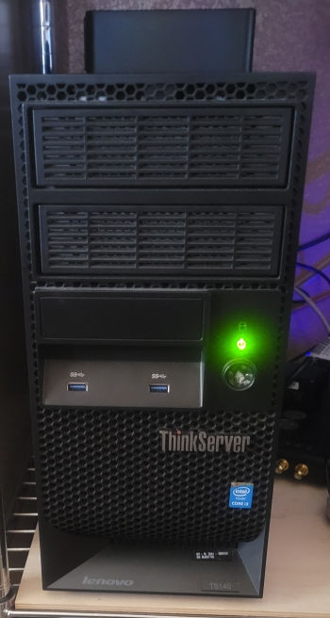
My NAS
Lenovo ThinkServer TS140 Intel i3-4130 2.4 GHz (dual-core) 24GB ECC DDR3 1600 MHz 4 x Western Digital 10TB HDD (data) Western Digital 3TB HDD (configs-data) Seagate 8TB External Drive (data) SanDisk Ultra-Fit 64GB USB (boot) 450 Gold Power Supply 1GB Ethernet
Software: OpenMediaVault 5.6 Docker/Portainer Plex Server Calibre-Web Server Ubooquity Server Kavita Reader Server Tautulli Server Heimdall Dashboard

Slide 9

Cochise Linux User Group

